Slide 1

COPERNICUS SERVICE C3S_311A_LOT2
WP2.3:CDM mapper tool overview
David Berry, Irene Peréz González, John Kennedy, Elizabeth Kent,
Eric Freeman and Chris Atkinson

Slide 2
OUTLINE
Tool overview
Installation
First tests
What the tool needs: data models
Reading (and validating) data
Data model validation explained
Performance
Current status
Issues

Slide 3
Tool overview
python3 tool designed to read meteorological data formats
Data format requirements:
Data are stored in a human-readable manner: “ASCII” format
Data are organized in single line reports
Reports have an internal structure that can be modelized*
Reports may be fixed width or delimited
Users / use modes:
Read historical data formats
Operational processing of current rt / nrt data formats
Common data exchange language between data providers and recipients (C3S-CDS)
* Wiki: A data model (or datamodel) is an abstract model that organizes elements of data and standardizes how they relate to one another and to properties of the real world entities

Slide 4
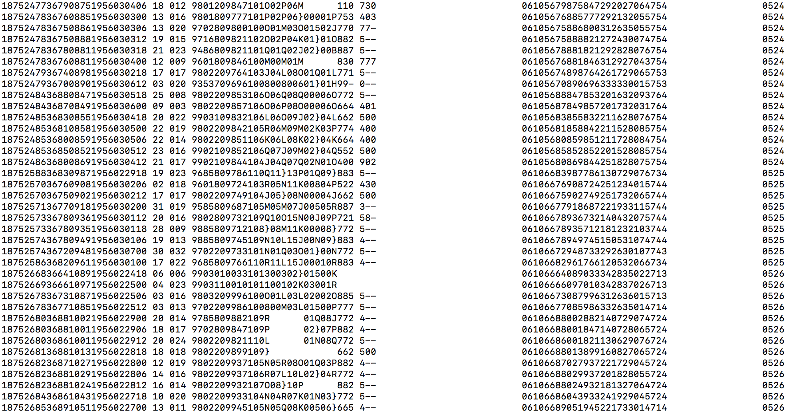
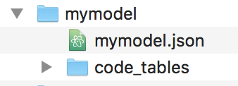
Tool overview
data file
data model
‘data’: pandas DF
‘valid_mask’: pandas DF
‘atts’: python dictionary

Slide 5
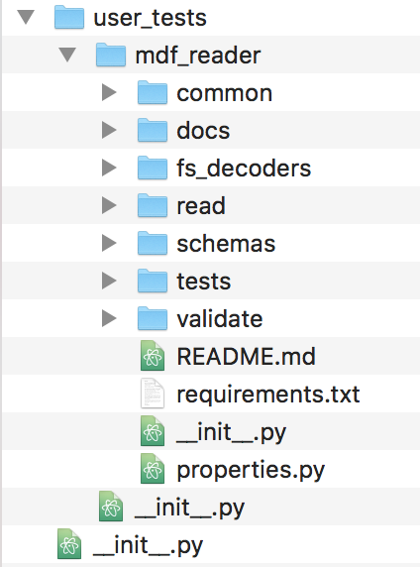
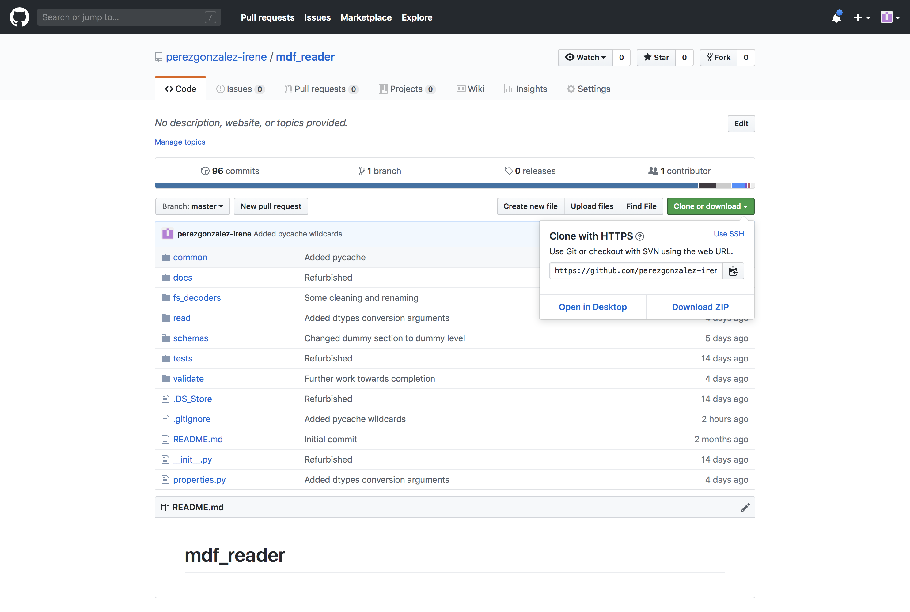
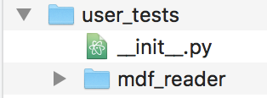
Get it working(I)
Get code from GitHub
Download zip from https://github.com/perezgonzalez-irene/mdf_reader.git
(rename mdf_reader_master to mdf_reader)
Clone repo: git clone https://github.com/perezgonzalez-irene/mdf_reader.git
Add the __init__.py file to the installation parent directory
Not in Python Package Index
__init__.py files are required to make Python treat the directories as containing packages

Slide 6
Get it working(II)
You can probably skip this and work with your default python3 settings
Create python3 virtual environment in tool directory
cd mdf_reader
Create environment
local:
python3 -m virtualenv^{(*)} --system-site-packages myenv
servers: 3 public servers that support anaconda-python3: Chelone, Typhoon and Themis
jasmin: (python3 still not default/operative, but following works)
1. Set path and activate conda environment
export PATH=/apps/contrib/jaspy/miniconda_envs/jaspy3.7/m3-4.5.11/bin:$PATH
source activate jaspy3.7-m3-4.5.11-r20181219
2. Create your own virtualenv - you only do this once!
virtualenv --system-site-packages myenv
Activate environment:
source ./myenv/bin/activate
4) Install specific package versions:
pip install -r requirements.txt
To deactivate environment:
deactivate
^{(*)} python3 -m pip install --user virtualenv

Slide 7
Try it(I)
Add the tool’s parent directory path to python path
toolsDir = ‘/Users/iregon/dessaps/user_tests’
Add in shell:
> export PYTHONPATH=$toolsDir:${PYTHONPATH}
> python
Add already in python:
> python
> import sys
> sys.path.append(toolsDir)
> import mdf_reader

Slide 8
Try it(II)
python:
> import mdf_reader
> import matplotlib.pyplot as plt
> imma_buoys = mdf_reader.tests.imma1_buoys_nosupp() or
> imma_buoys = mdf_reader.tests.imma1_buoys_supp() or
> td11_dck187 = mdf_reader.tests.td11_deck187_nosupp() or
> td11_dck187 = mdf_reader.tests.td11_deck187_supp()
> type(imma_buoys), print(imma_buoys.keys())
(<class 'dict'>, None)
dict_keys(['data', 'atts', 'valid_mask'])

Slide 9
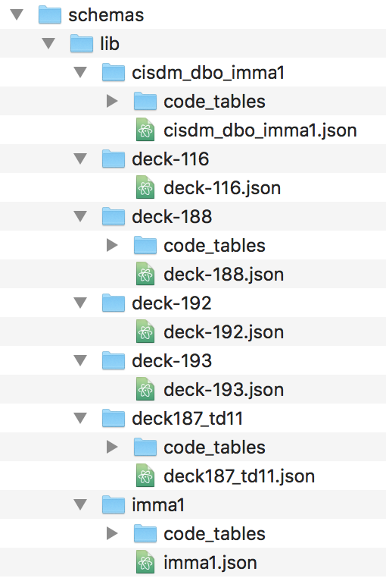
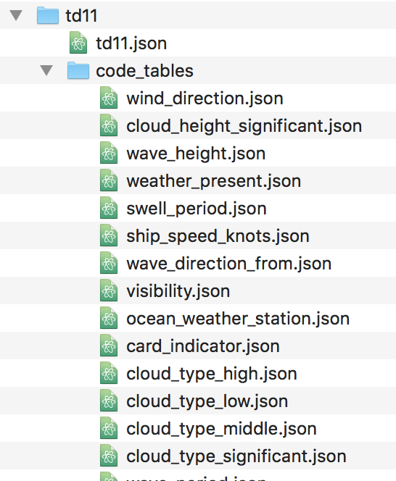


First steps - data models
mdf_reader uses the information provided in a data model to read meteorological reports to a pandas DataFrame
Data model: schema file + code tables
Supported data formats/models:
The data model (schema / code tables) is registered within the tool
models|schemas = mdf_reader.properties.supported_file_formats
Rest:
No model (schema / code tables) for data format is registered in tool
If the file format meets the tool specifications, then a model can be built externally and fed into the tool
Data model for TD11

Slide 10
First steps– build external data model (I)
Steps to create a file format/data model that is not supported:
Create a valid directory tree to hold the model
Create a valid schema file /mymodel/mymodel.json
Create valid code tables /mymodel/code_tables/table_name[i].json (if…)

Slide 11
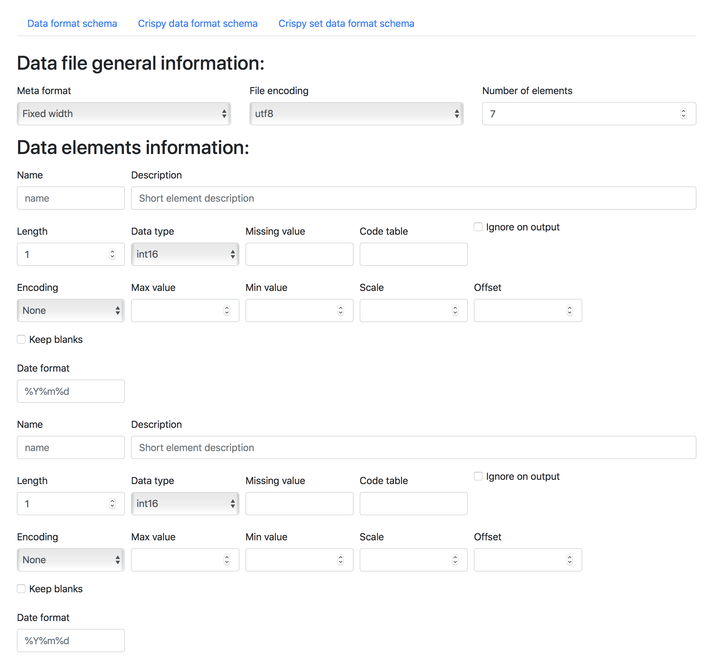
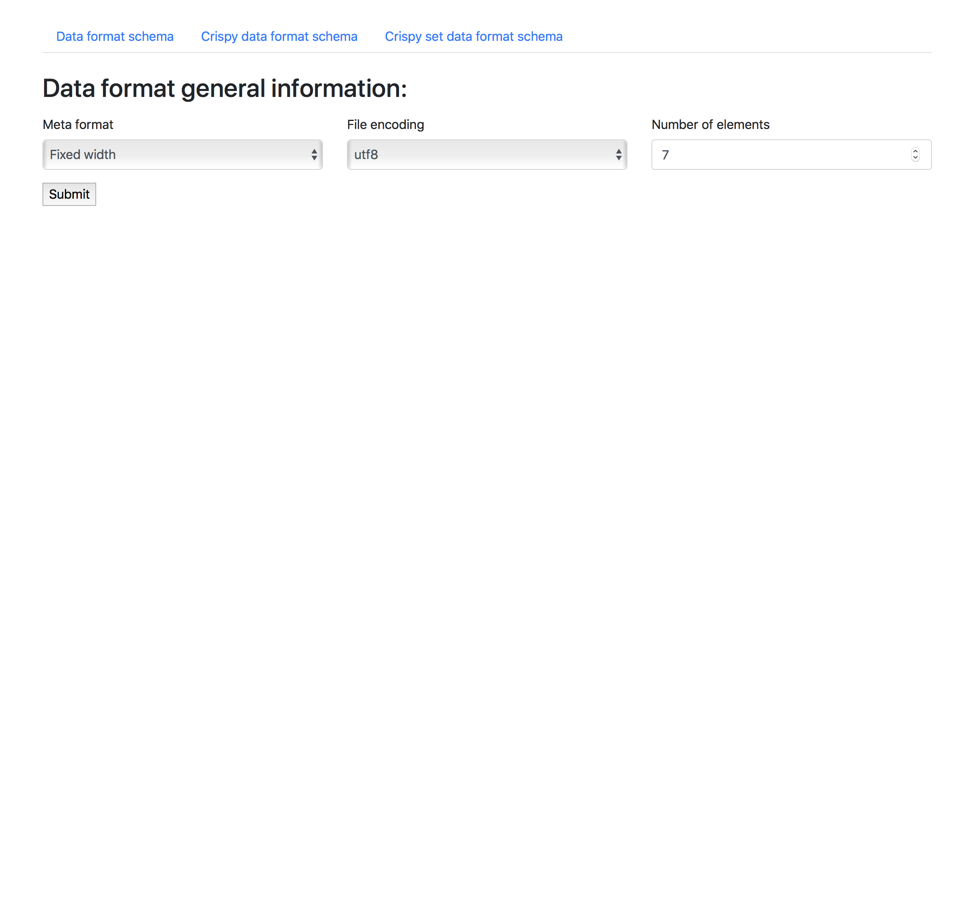
First steps– build external data model (II)
Creating a valid schema file for the data format
…A data format schema is a collection of descriptors that enable the mdf_reader to access the content of a data format and to extract the data it contains to meaningful units of information….
Decide the basic model for your data format:
Is it fixed width or delimited
Does it have one section or multiple?
…..
Via web app: under development…..
Numeric
Object
Datetime
Copy a template, edit and fill in.
> python >
> import mdf_reader
> templates = mdf_reader.schema.templates()
> mdf_reader.schema.copy_template(template, mypath)

Slide 12
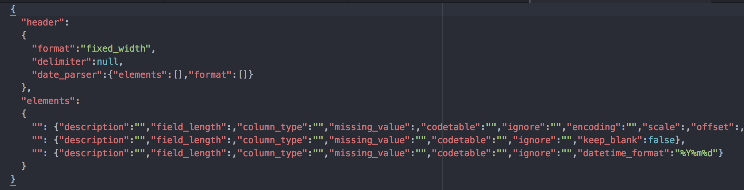
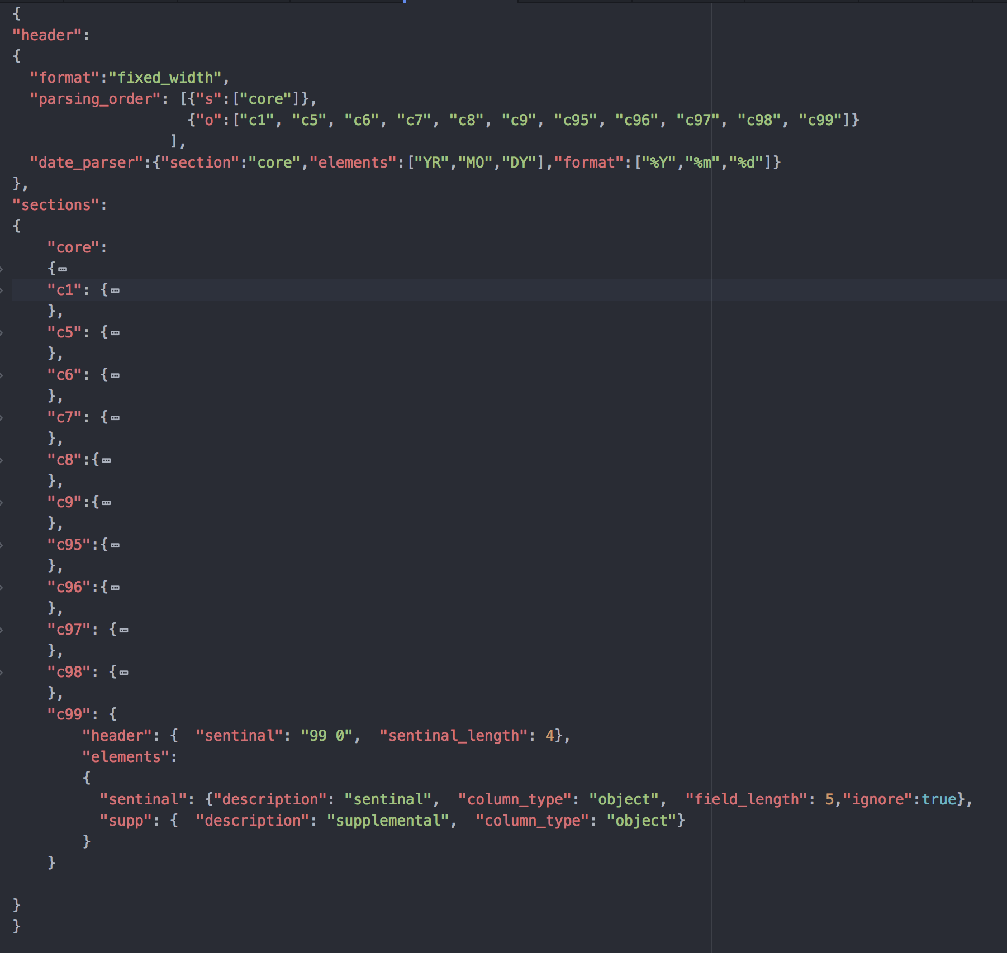
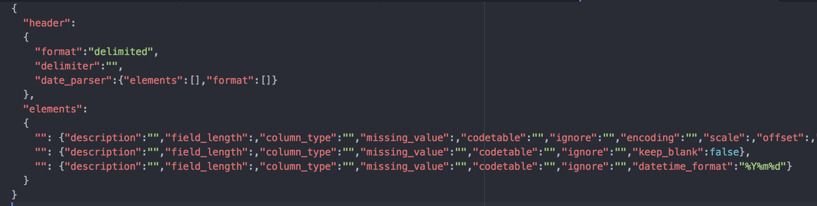
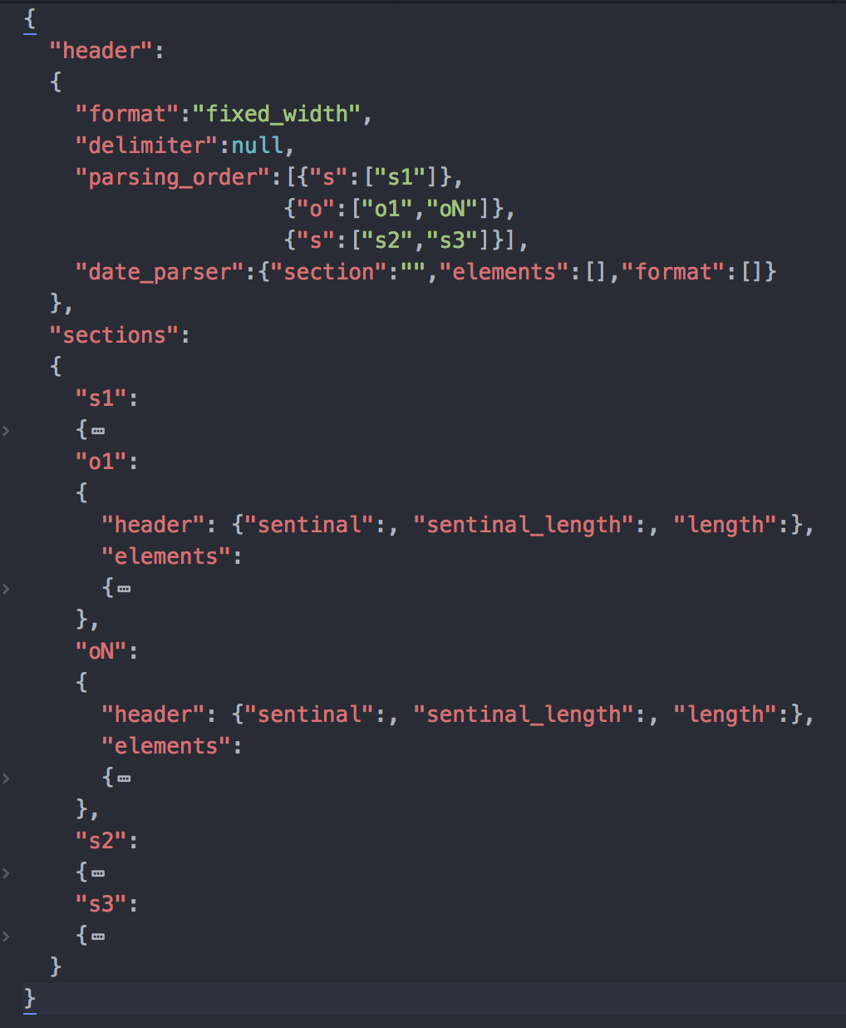
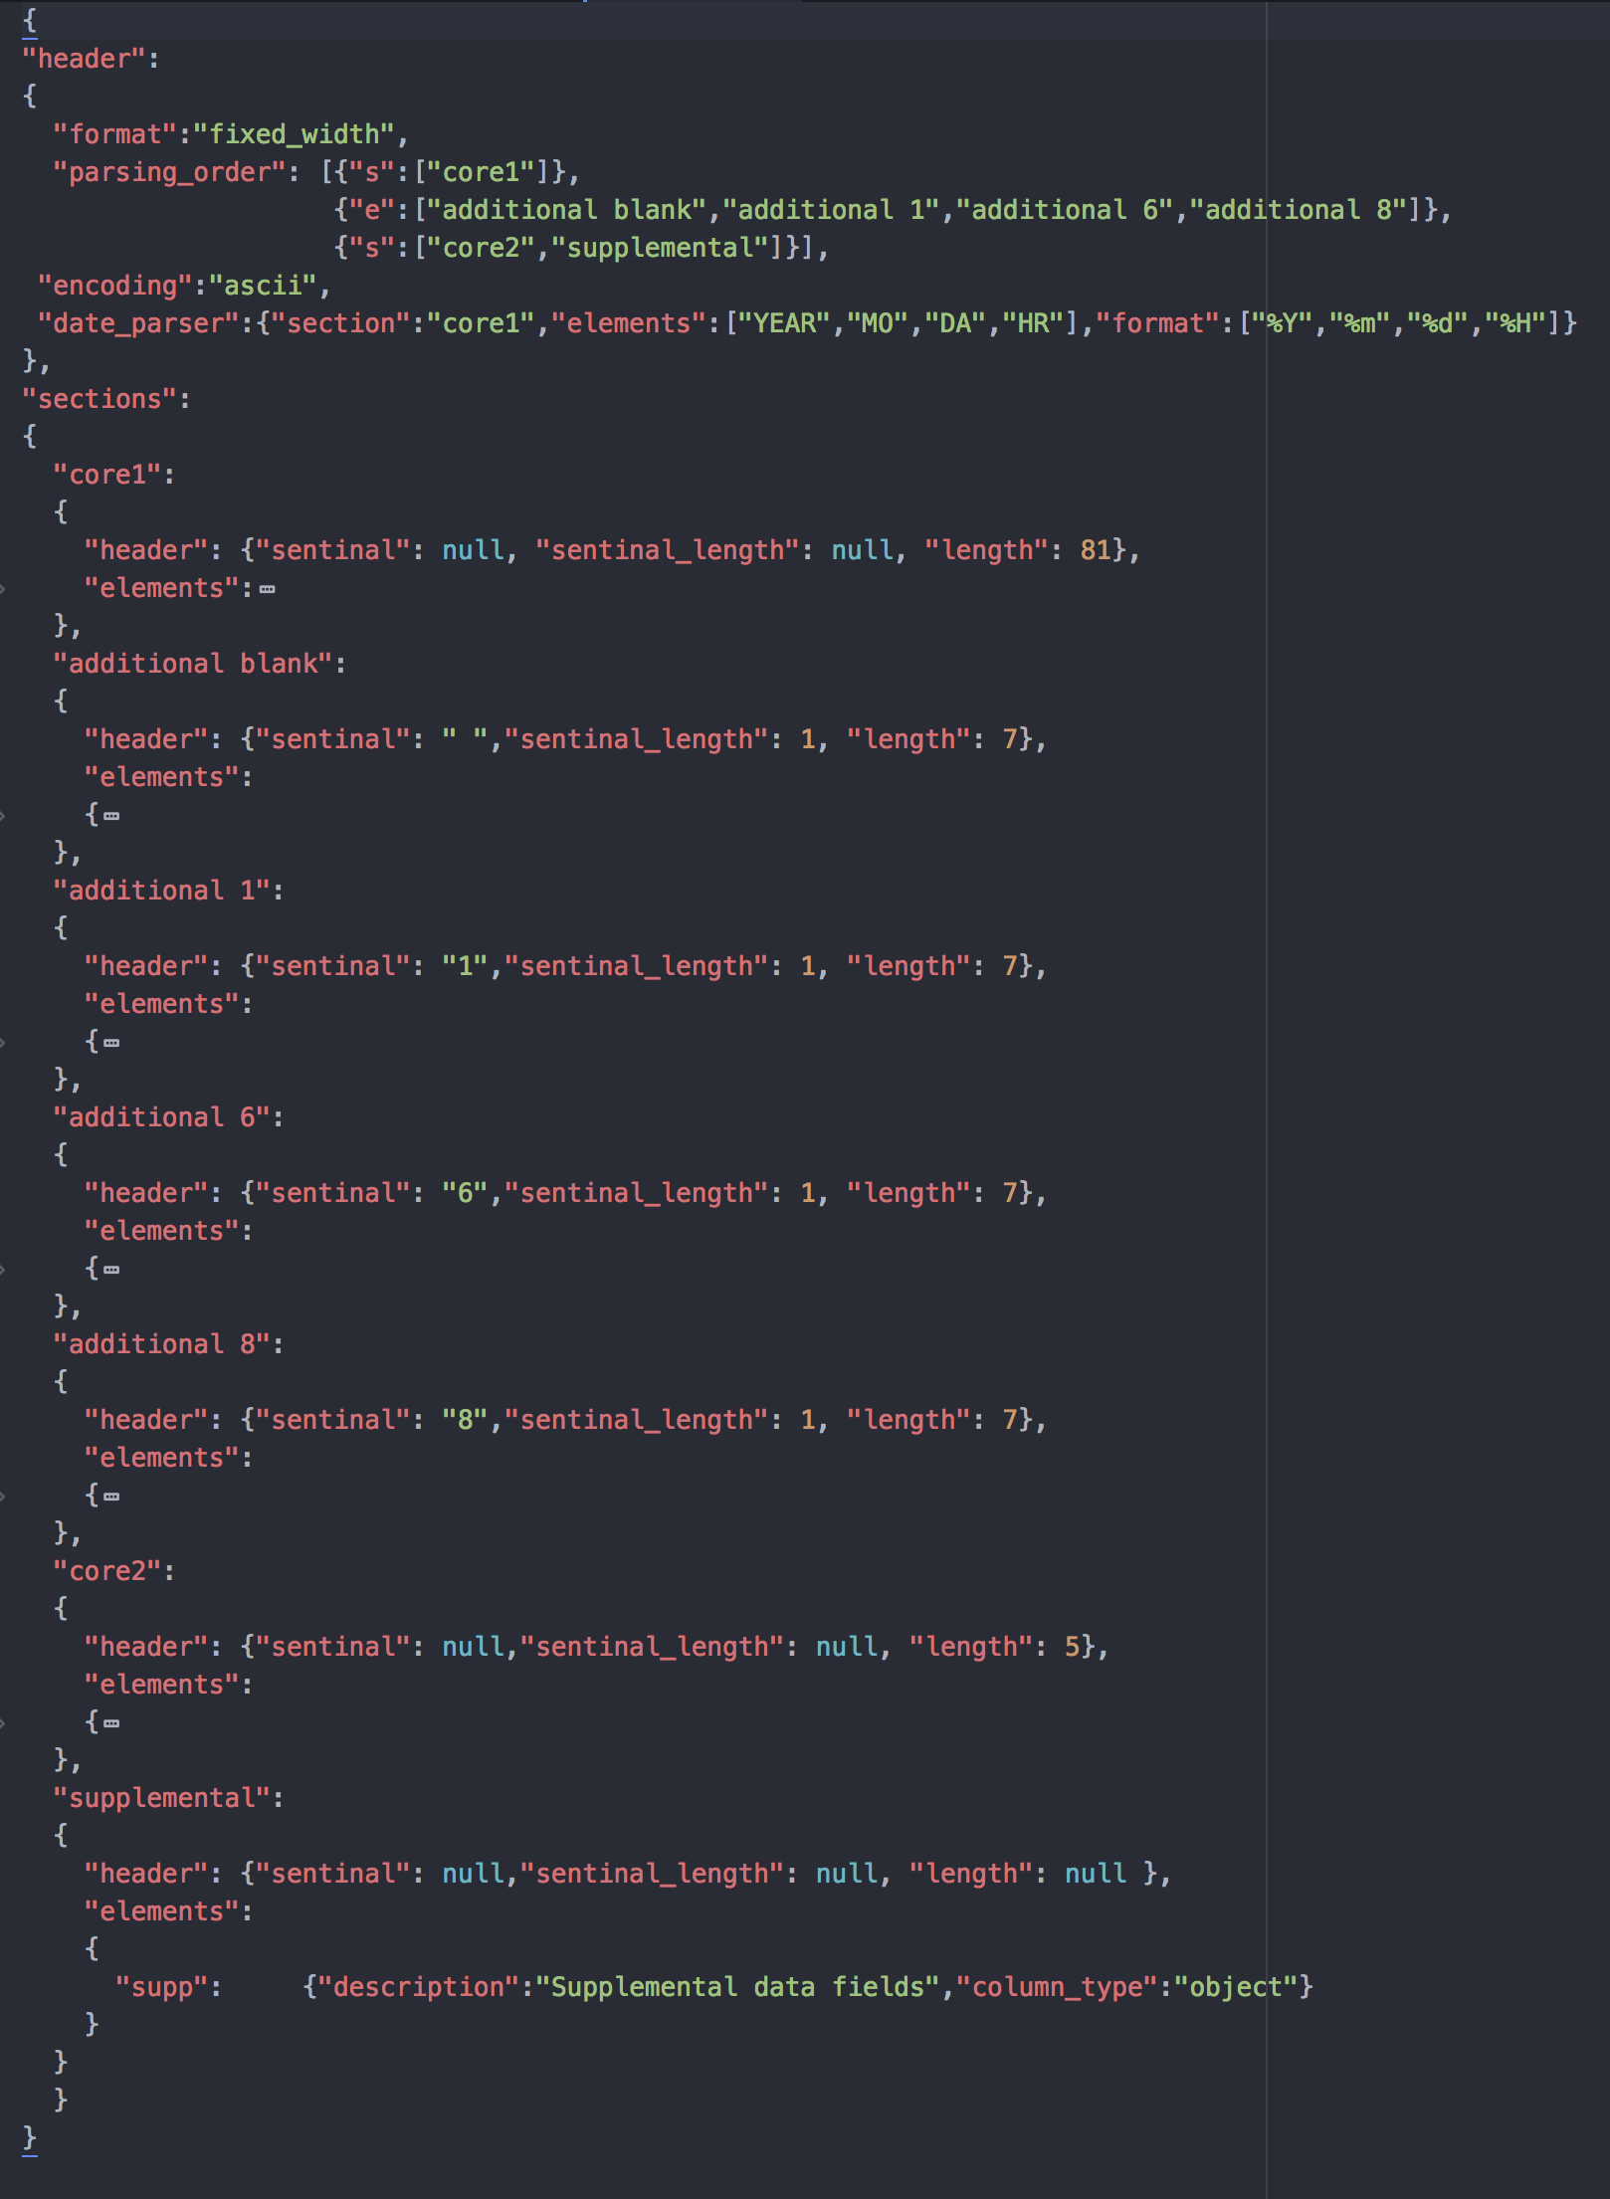
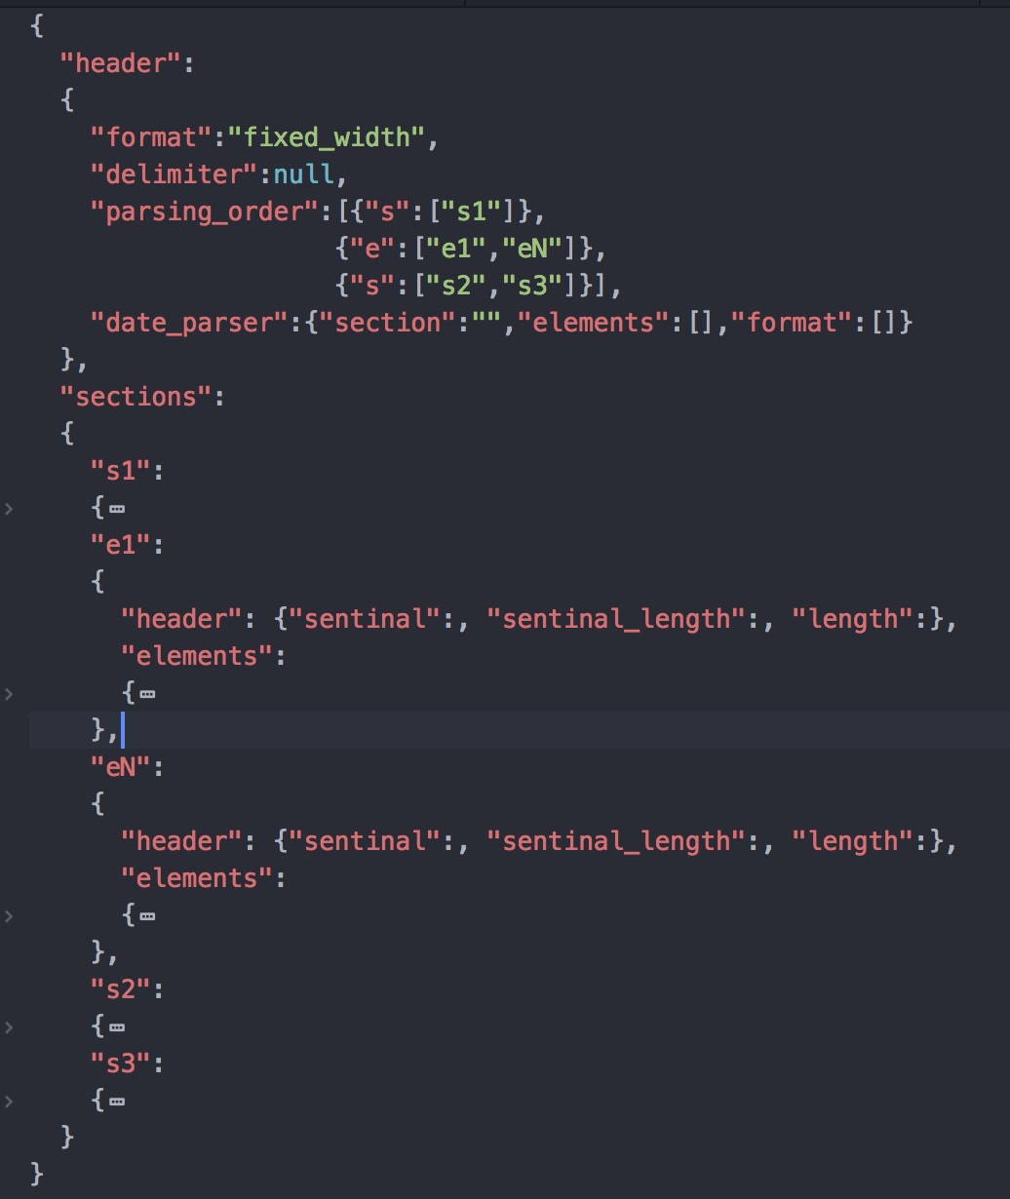
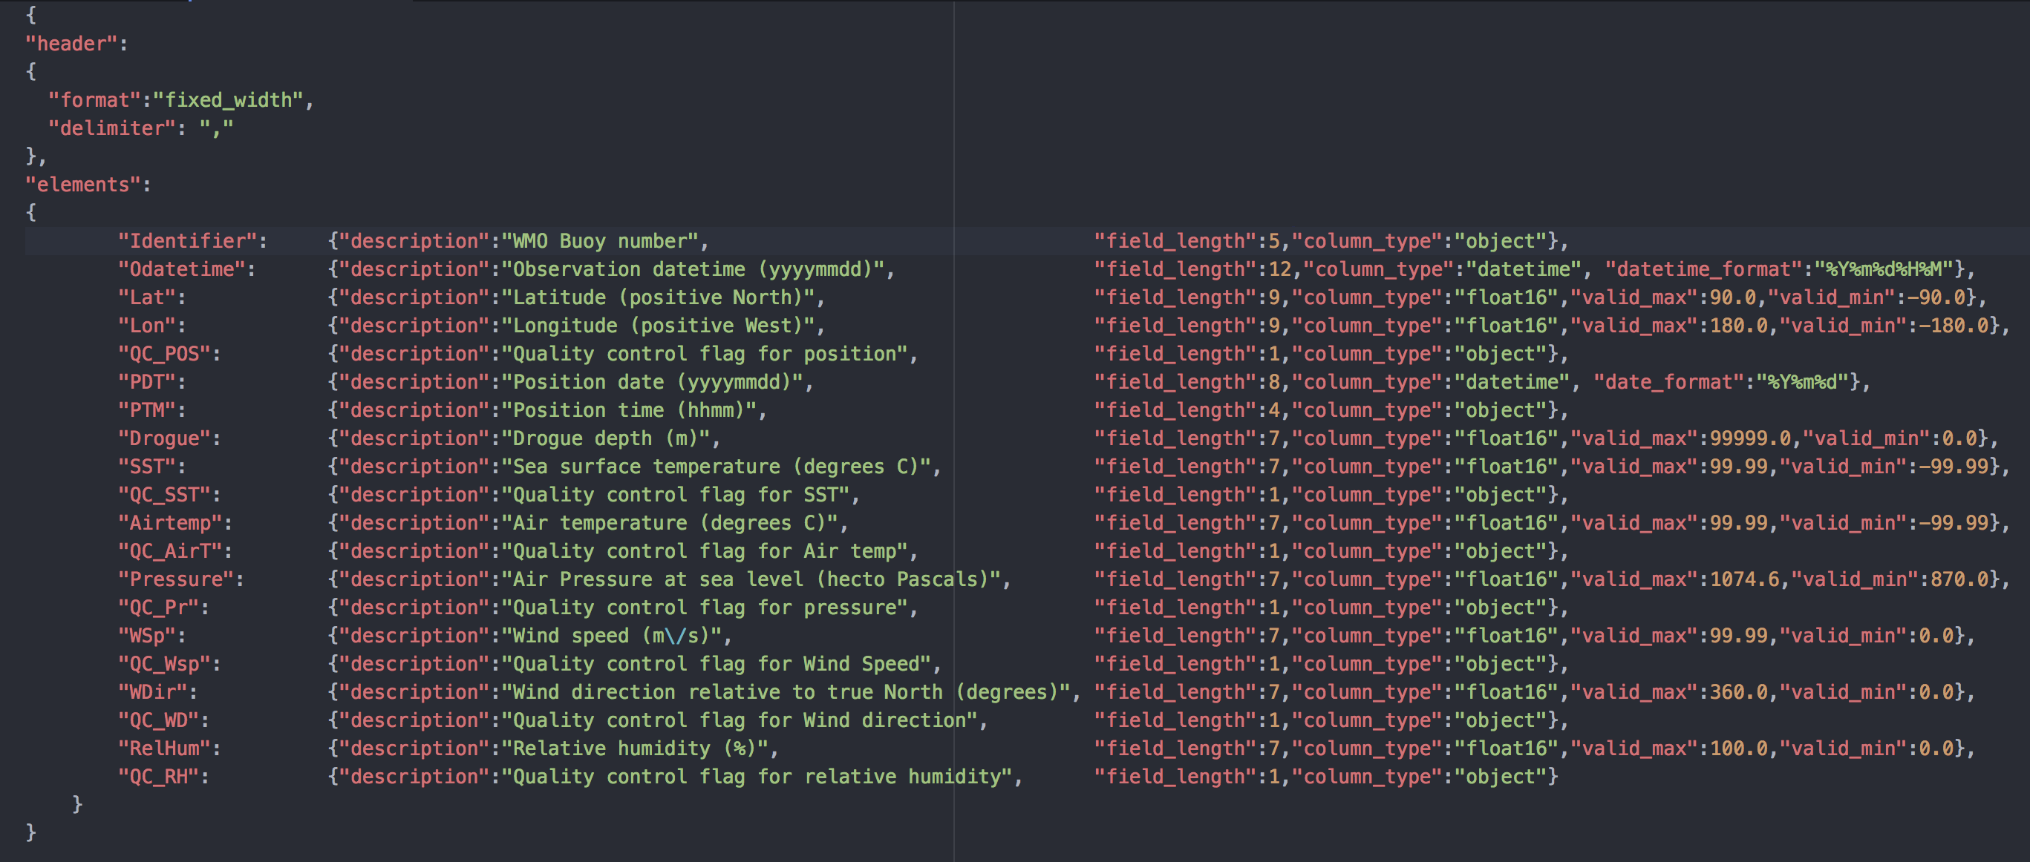
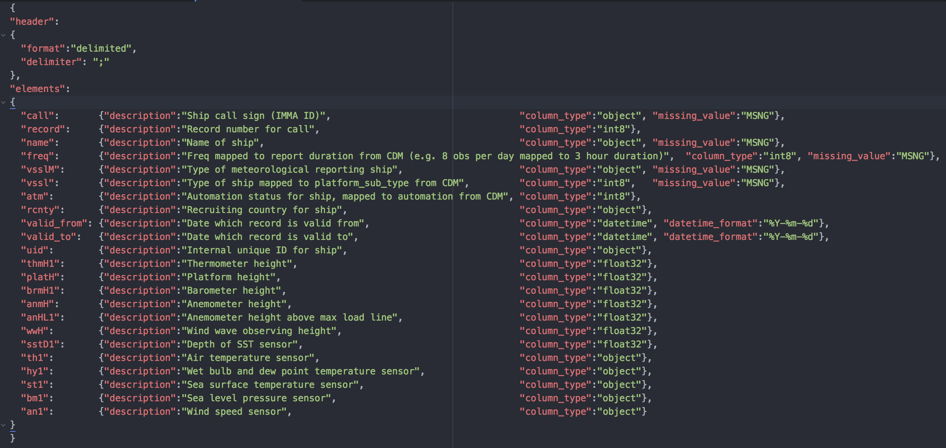
First steps– build external data model (III)
Example schema templates and files
delimited_1_section
pub_wmo47 (…)
fixed_width_1_section
cisdm_dbo_imma1
fixed_width_x_sections_opt
imma1
fixed_width_x_sections_exc
td11

Slide 13
First steps– build external data model (IV)
Creating a valid schema file for the data format
Schema descriptors/attributes are specified in manual
Some element descriptors are element data type specific
Numeric: encoding, scale, offset, valid_max, valid_min
Object, str, key: keep_blank
Datetime: datetime_format
How data elements are ingested and validated is also data type specific
dtype | ingestion | validation
numeric | decoding: base36, signed_overpunch conversion: offset, scale missing data | range
datetime | conversion missing data | datetime
key | missing data | table code
object, str | missing data | None

Slide 14
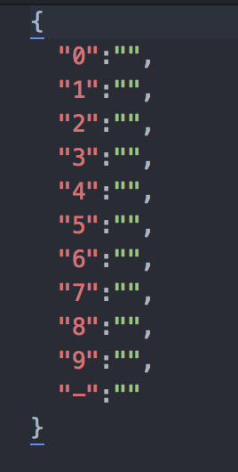
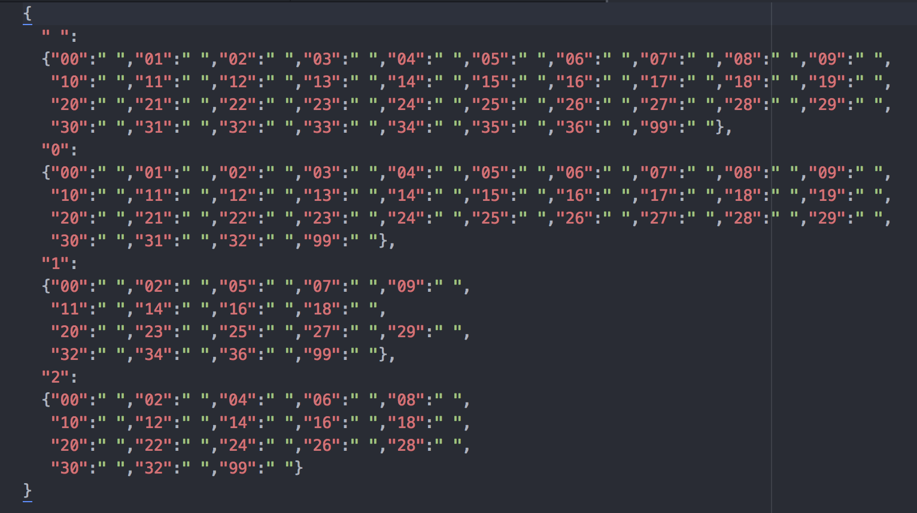
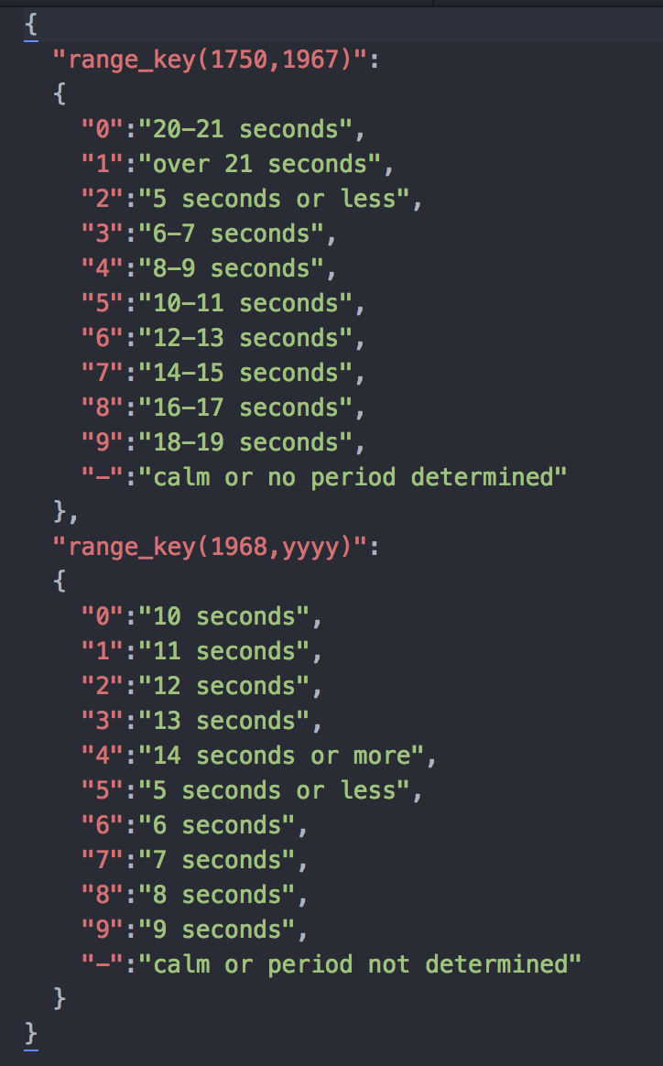
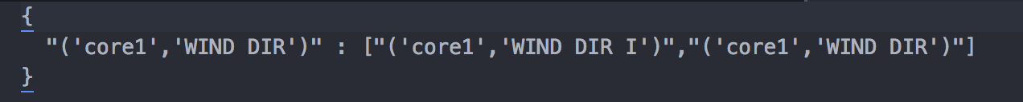
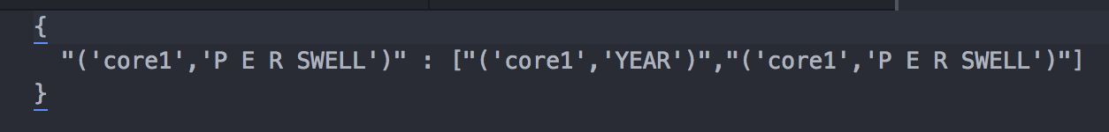
First steps– build external data model (V)
Creating valid code tables
Code tables contain the key:value pairs of the coded elements in a data model Every code table is stored as an individual json file
Code tables are described in manual
Simple
Nested
Range-keyed
simple_table.json
nested_table.json
range_table.json
nested_table.keys
range_table.keys

Slide 15
Read data
Running from terminal (set out_path!):
> export PYTHONPATH=$toolsDir:${PYTHONPATH}
> python toolsDir/mdf_reader/reader.py source **kwargs
In python:
> import mdf_reader
> data = mdf_reader(source, **kwargs)
﻿source
options:
data file (supports chunking via chunksize = chunksize)
pd.DataFrame (does not support chunking)
pd.io.parser.TextFileReader (inherits chunking)
KWARGS:﻿
mandatory:
data_model or data_model_path
optional:
sections, skiprows, out_path, chunksize
supp_section and supp_model or supp_model_path

Slide 16
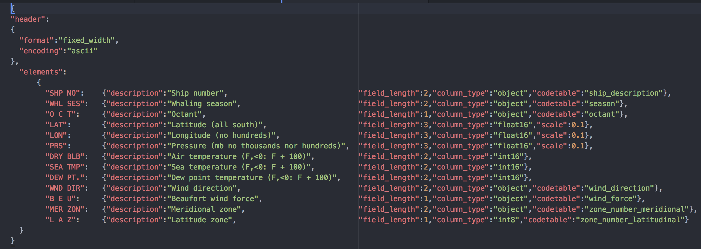
Read data – input and kwargs
data file
data models.schemas
(core + supplemental)
input

Slide 17
Mapping dataflow
data frame
process
imodel.functions
imodel.data
data model element attributes
data frame attributes
imodel.code_tables
imodel.
cdm_table_map(i)
imodel.
cdm_table_map(i)
cdm_table.atts
data types
object
missing
﻿’null’
imodel.mapping.cdm_table
dtype_printers
decimal_places
cdm_table.atts
data_type
update_atts
elements, transform, kwargs,
code_table, default,fill_value
cdm_table.data
print_cdm_table_fields
create_cdm_table_fields
cdm_table.data
to_csv
data types
cdm_table.atts
missing
﻿NaN, fill_value
cdm_table.psv

Slide 18
Data model validation
Model validation occurs at the data elements value level
Validation is element dtype specific:
dtype | validation check
numeric | range
datetime | datetime*
key | table code
object, str | None
Validation output: does NOT remove invalid data, creates a MASK
Boolean dataframe (True|False)
Dimensions: same as data
Exceptions:
Missing values: True
Numeric elements where either upper|lower bound is missing: False
Table code elements where no code table is not found: False
Non “validatable”: NaN

Slide 19
Data model validation(II)
input
output

Slide 20
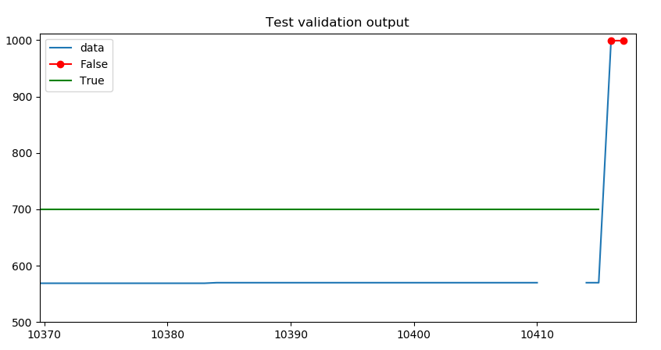
Data model validation(III)
Validation test
python>
from mdf_reader.tests import tests
import matplotlib.pyplot as plt
import pandas as pd
[data,mask] = ﻿tests.validate_td11_deck187_nosupp()
﻿ax = data['core1']['MAR SQ'].plot(label = 'data')
data['core1']['MAR SQ'].where(~mask['core1']['MAR SQ']).plot(marker = 'o',color = 'r',ax=ax,label='False’)
trues = pd.Series(index = data.index,data = 700)
trues.where(mask['core1']['MAR SQ']).plot(color = 'g',ax=ax,label='True')
plt.legend()
plt.title('Test validation output’)
plt.show()

Slide 21
Performance…
2010-07.imma (buoys)
1.126.697 records
(reading only)
New reader(local, no chunking (!), all sections ([core,c1,c98,c99]), supplemental): 15.18 minutes
New reader(local, chunk = 100000, all sections ([core,c1,c98,c99]), supplemental): 12.36 minutes
Beta release(CEDA, chunk = 100000, [core,c1,c98,c99], supplemental): 20 minutes

Slide 22
Current status
Tool reader and validation working:
outputs data and validation masks as expected
Available in GitHub but will add to GitLab week 1 April:
will then mail you so you can have access
Some issues need to be addressed, though
Schema/data model library needs to be populated:
priorities (C3S deliverable + other projects)
v0 or v1.0 release?
how this relates to populating the library?
by start of C3S processing?
Web app:
Schema file (simple?) generation is priority
Read tester (…..): plug in reader to do test reading and simple output representation

Slide 23
Issues
Data flow:
Chunking
Mark through the dataflow NaNs that result from error in decoding/conversion: these are not gaps
Dataframe specific schema: file schema Vs dataframe (read data) schema
Element special packings/encodings/conversions:
special functions inside file schemas for supported formats
will need a special attribute in schema
Missing value: make sure working|included in decoders, converters.object_to_datetime, functions.df_prepend_datetime
Configuration:
Code table elements:
own column_type: ‘codetable’-key (treat as objects)
not primary code table keys have also their code tables and are declared as code_table
the last does not apply to real numeric data that might enter as key, such as year
Remove precision from schemas
Need to clarify vocabulary: mode, schema, data format…..in docs, plus apply in code
Attributes: add strip_whitespaces, element encoding/packing attribute name
Verbosity and exception handling:
Exception handling!!!
Logging versus error printing
Version control, access
Repositories: move this to GitLab
Name: see if someone has a bright idea

Slide 24
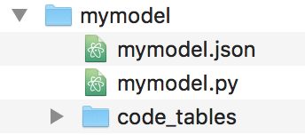
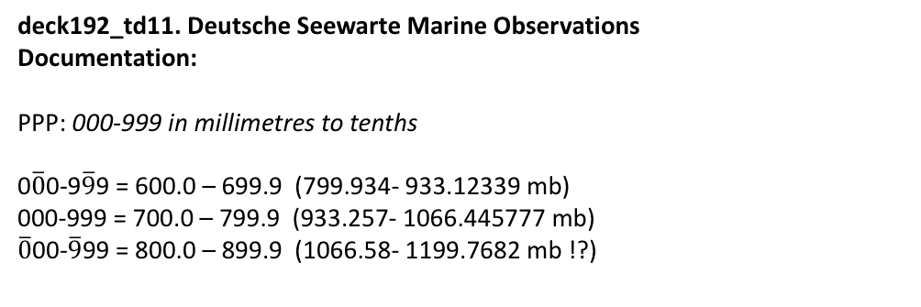
Issues
deck192_td11. Deutsche Seewarte Marine Observations
Documentation:
PPP: 000-999 in millimetres to tenths
0$\overline{0}$0-9$\overline{9}$9 = 600.0 – 699.9 (799.934- 933.12339 mb)
000-999 = 700.0 – 799.9 (933.257- 1066.445777 mb)
$\overline{0}$00-$\overline{9}$99 = 800.0 – 899.9 (1066.58- 1199.7682 mb !?)
Data:
core (mb) | core (mb) to mmHg | supp
1015.5 | 761.6875 | 616
1009.0 | 756.8121 | 568
1023.0 | 763.313 | 67blank
1009.0 | 756.8121 | 57blank
deck187_td11. Japanese Whaling Fleet Observations
Documentation:
PRS:
…millibars and tenths with thousands and hundreds positions omitted: means that values range from xx00.0-xx99.9.
highest tens assumed to be 9yy mb (could potentially be 8yy mb?)
lowest tens assumed to be 10yy mb (could potentially by 9yy mb?)

